Slide 1
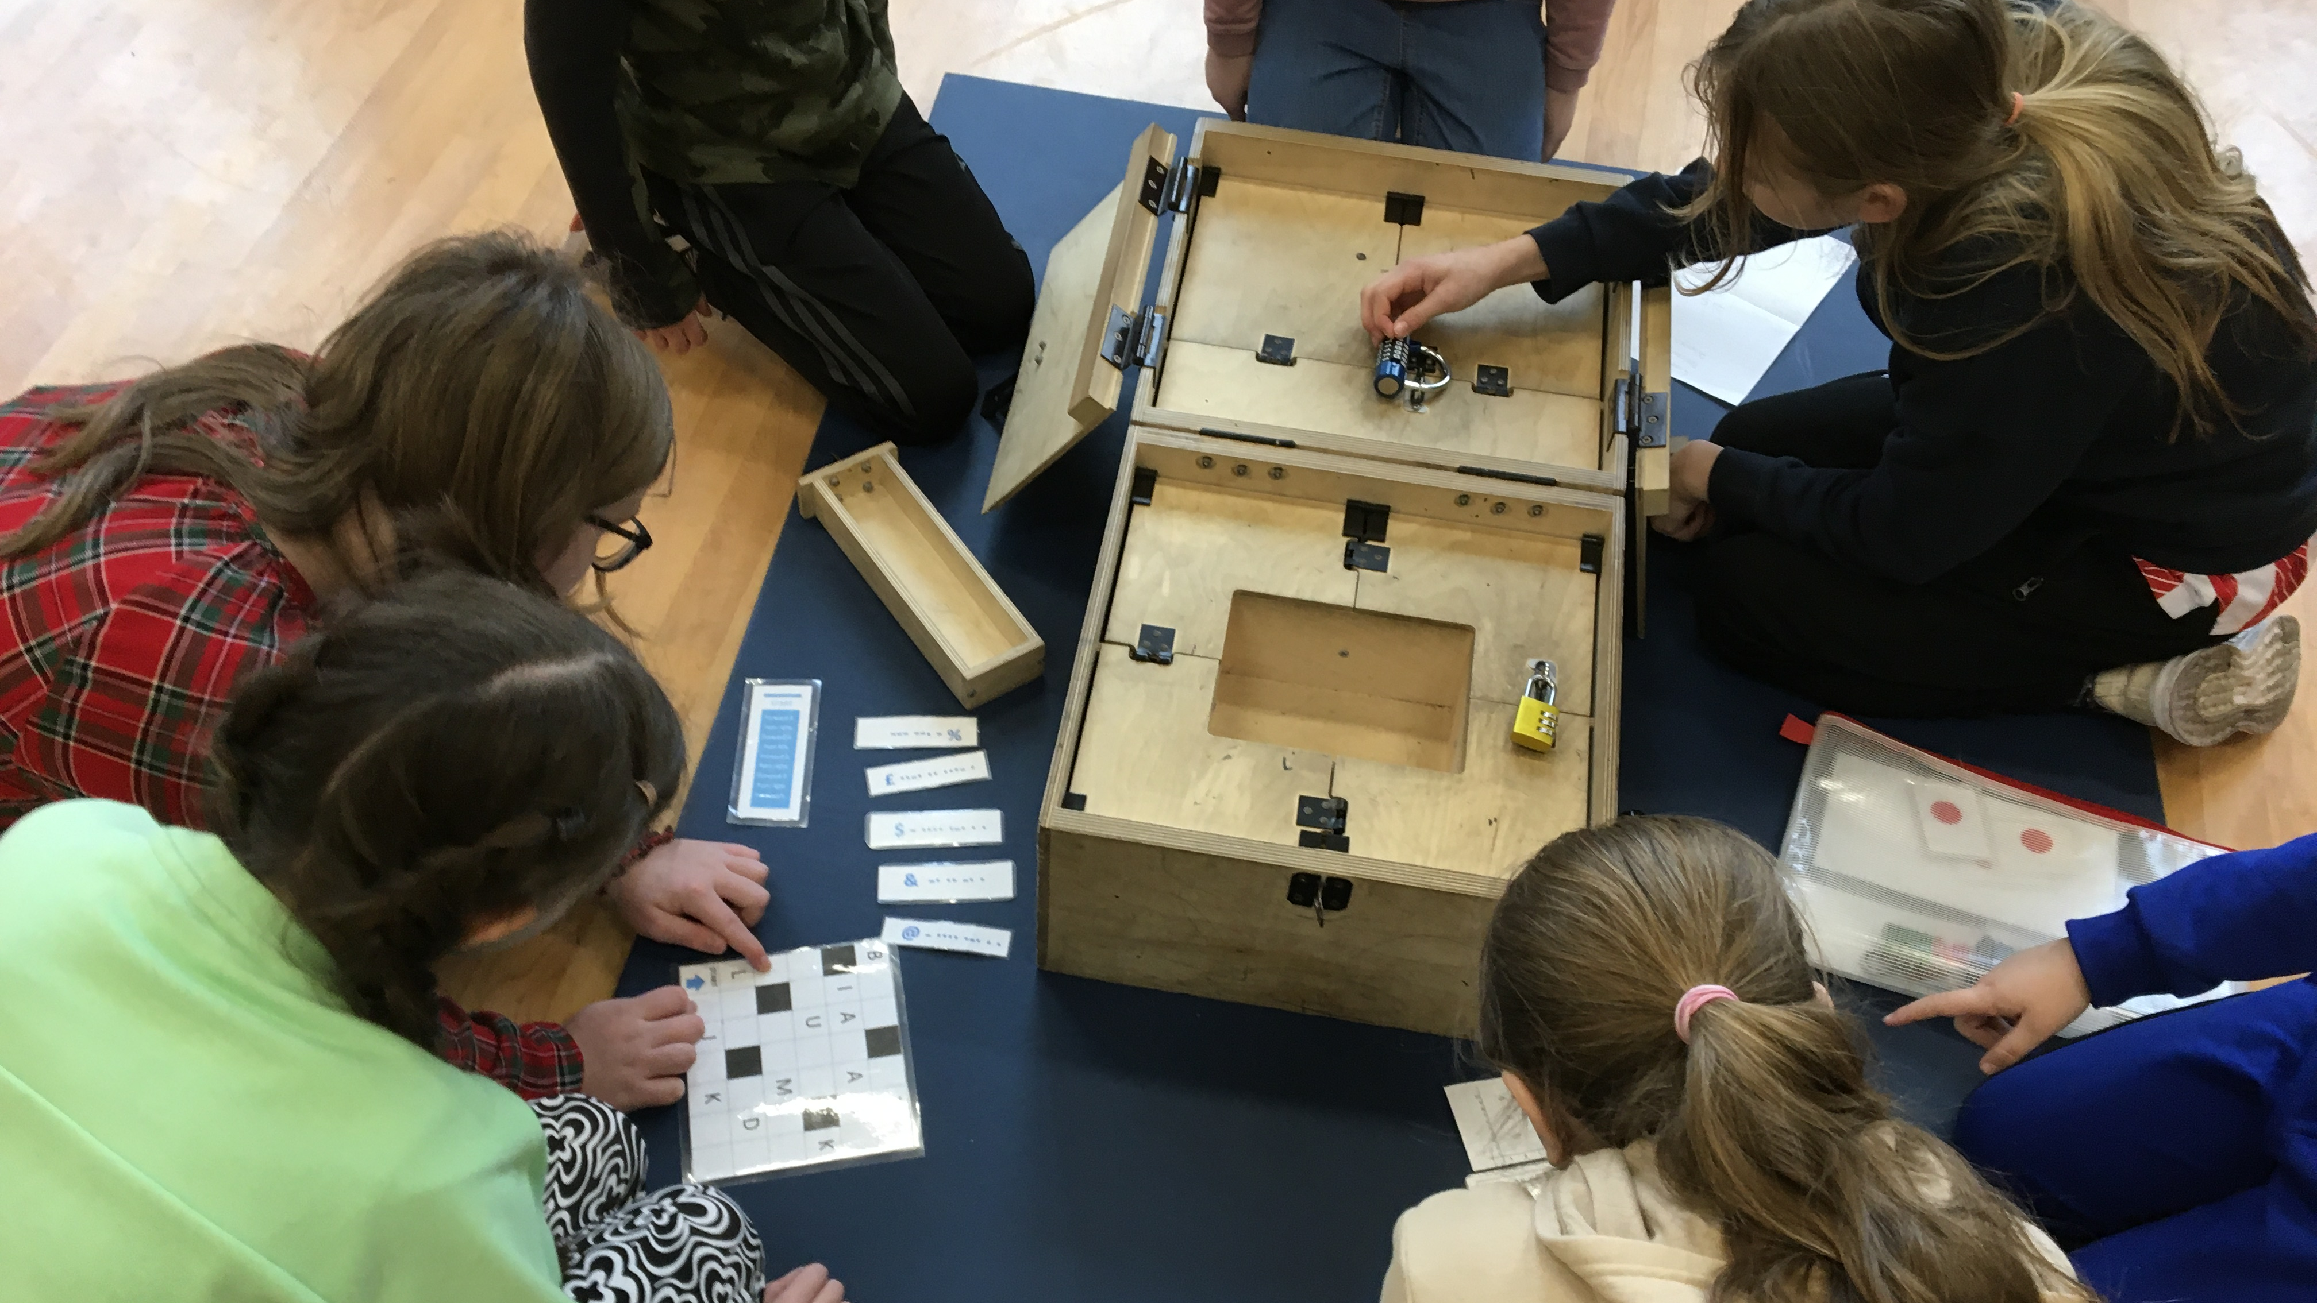
Problem Solving on Saturday
We had a brilliant day of puzzles and problem solving in the company of George from ‘The Problem Solving Company’. We had to work together to solve the clues and sequences to allow us to open all the padlocks to get to the ‘final’ key to stop the clock. George said how quick and efficient we were and how impressed he was with all of the invited children from our school. After the locked-box mysteries, we went onto the mathematical puzzles and problems where we had to use trial and improvement to find the many solutions.

Slide 2
