Slide 1


Early Reading and
Jolly PHonics

Slide 2
At Churchfields Primary School we know the importance of reading. Teaching children to know the letter sounds is crucial in their early reading progression.
This powerpoint accompanies the video of how we use Jolly Phonics to teach these early reading skills. We hope you find it interesting and useful. Please contact your child’s teacher if you have any further questions.

Slide 3
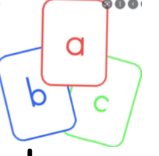
In Phonics, we focus on sounds.
There are 44 sounds in the English language.
/a/ and /ay/ are 2 different sounds.
Children learn the letter names ("ay, bee" etc.) but when reading we want them to use the letter sound, not the letter name)

Slide 4
We don't learn the sounds in alphabetical order. Instead we follow an order which means the children can start making and reading words early on.

Slide 5

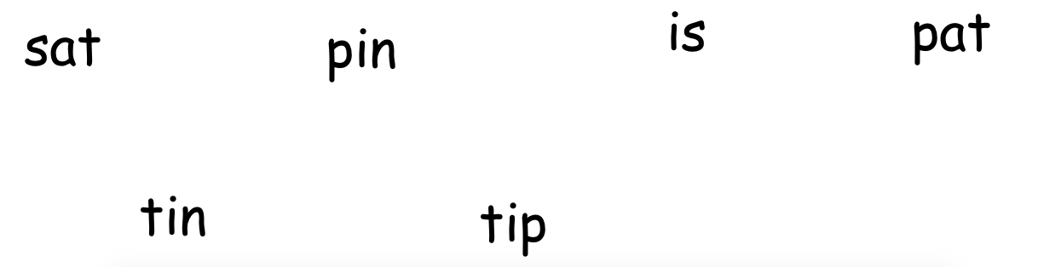
How many words can you make with:
s a t i p n

Slide 6
How many words can you make with:
s a t i p n

Slide 7
'Pure' sounds
When reading a sound, we make sure it is just the 'pure' sound we are saying.
Don't add a 'uh' to the end of a sound!
This makes it trickier for children to blend the sounds together.
Instead, say the pure sounds
c-a-t
Then the child can blend the sounds together and read the whole word.

Slide 8
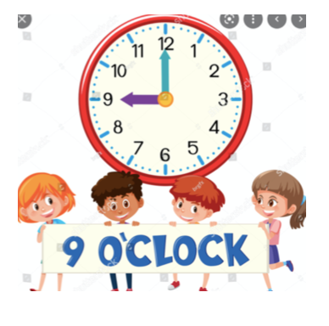
Phonics lessons take place
every day at 9am
They last about 15-20 minutes on the carpet, before going off to do independent learning.

Slide 9
Typical phonics lesson
Recap of sounds already learned.
Introduce sound of the day (3 new sounds a week).
Practise sound of the day - identifying it, reading it, writing it.
Application of sound of the day - read or write it as part of words.
Then, children go into the provision to do play-based activities with a link to the sound of the day. They are called in groups to practise writing in their Phonics book with the class teacher.

Slide 10
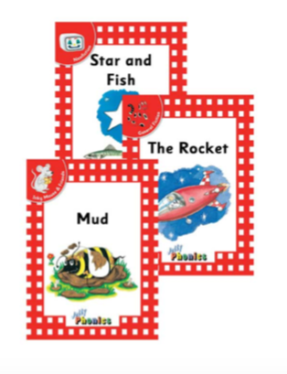
Reading books
When we reach half-term we should have got to a point where we have covered a good amount of sounds. Therefore, when we return after half-term, we will start sending reading books home for you to share with the children.

Slide 11

Importance of reading at home
Reading at home is so valuable as it provides opportunities for further progression in children's reading skills and abilities. It helps to consolidate learning carried out at school, as it allows them to put their learning to practice. Not only does it provide significant experiences to enhance learning in the home environment, it also provides chances for you, as parents and carers to watch and be involved in the development of your child's reading.

Slide 12

Unsure about how to pronounce a sound?
Worry not- on our school website we will have links to YouTube clips that cover all sounds we will be learning in Reception ☺

Slide 13
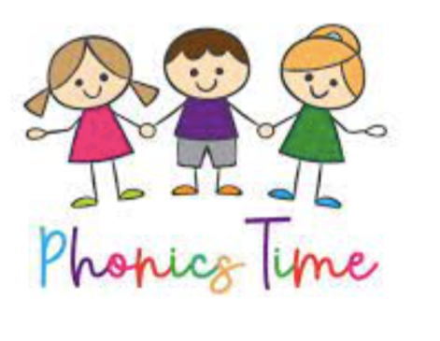
Time to practise some sounds!

Slide 14
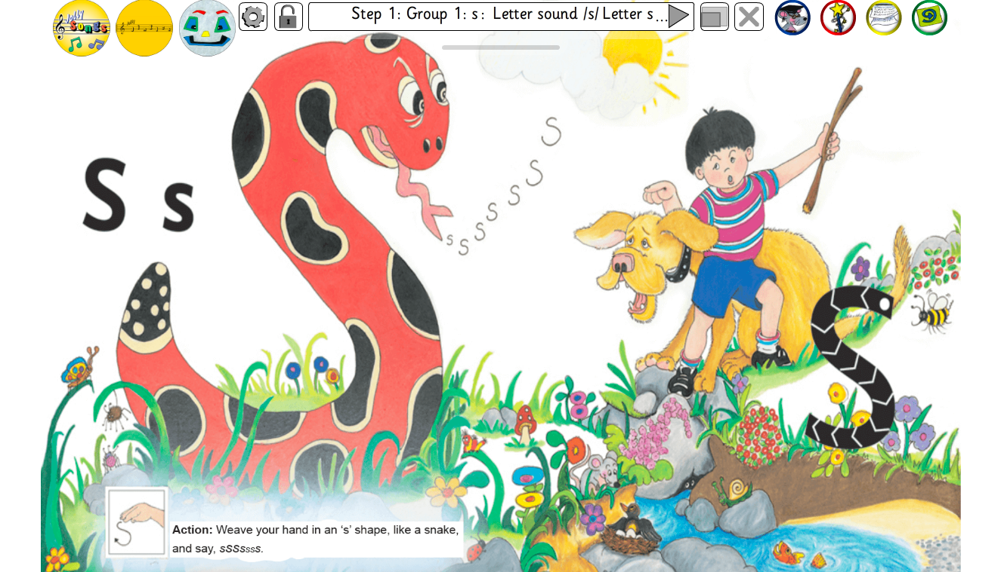
https://www.youtube.com/watch?v=APts0BQi0LA

Slide 15
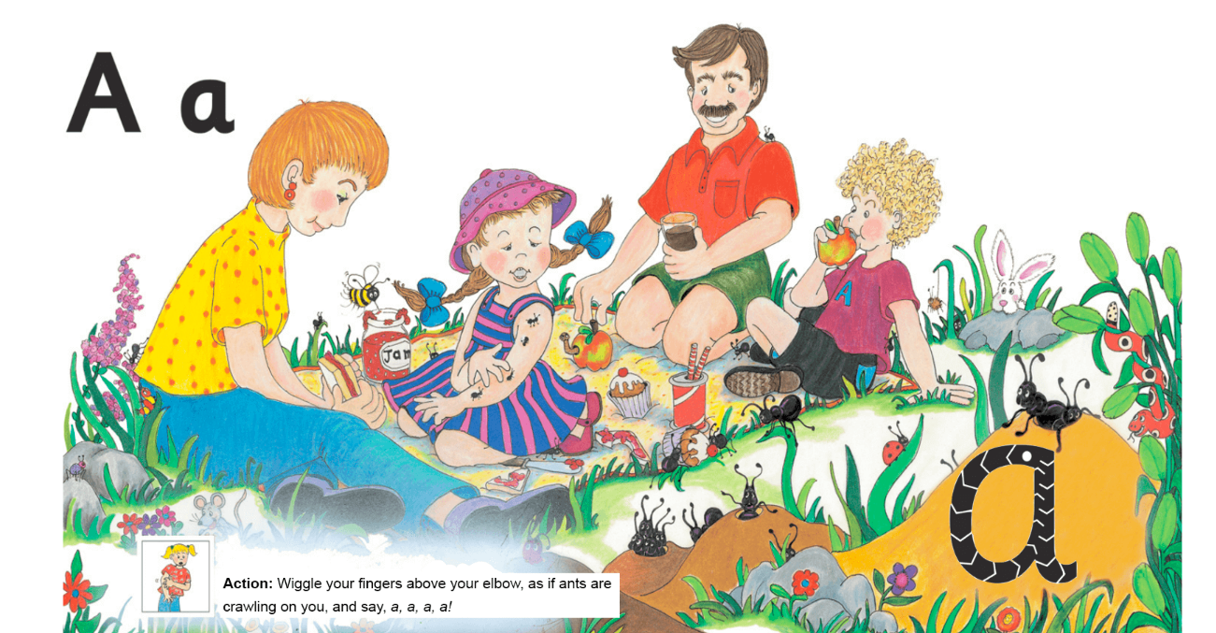
https://www.youtube.com/watch?v=2Xy2e78qxN

Slide 16
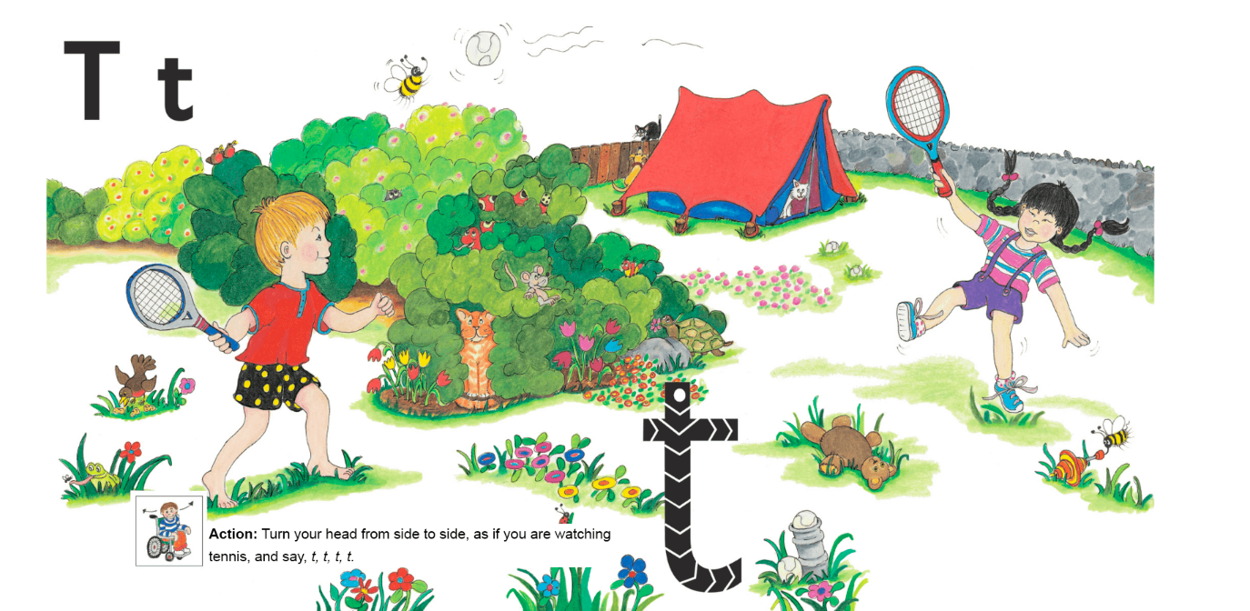
https://www.youtube.com/watch?v=t6Pn2zVz3eo

Slide 17
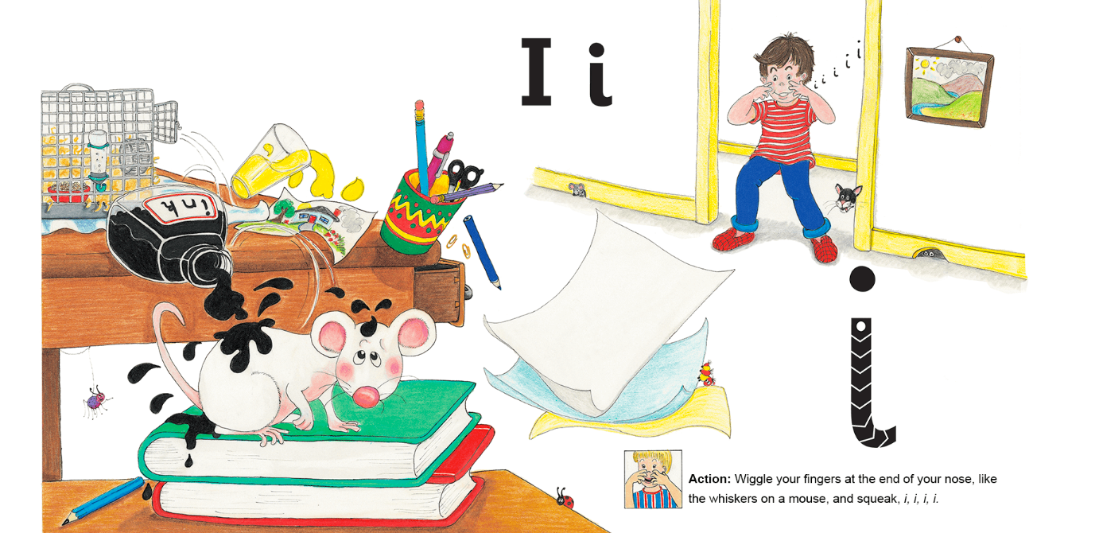
https://www.youtube.com/watch?v=QL7w-PAQUb8

Slide 18
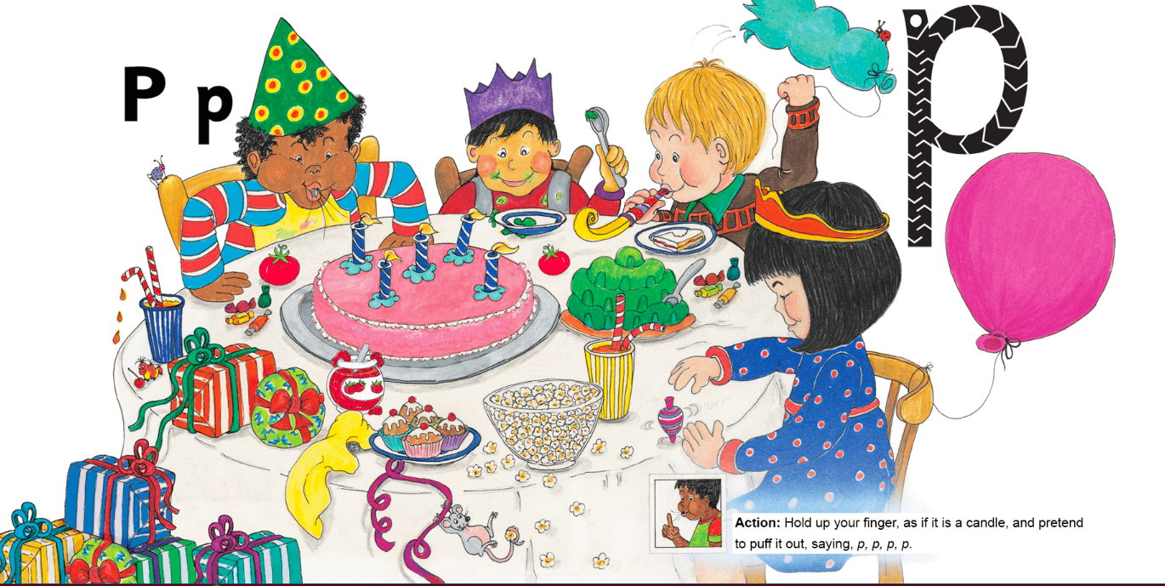
https://www.youtube.com/watch?v=CDo6o9Wmn60

Slide 19
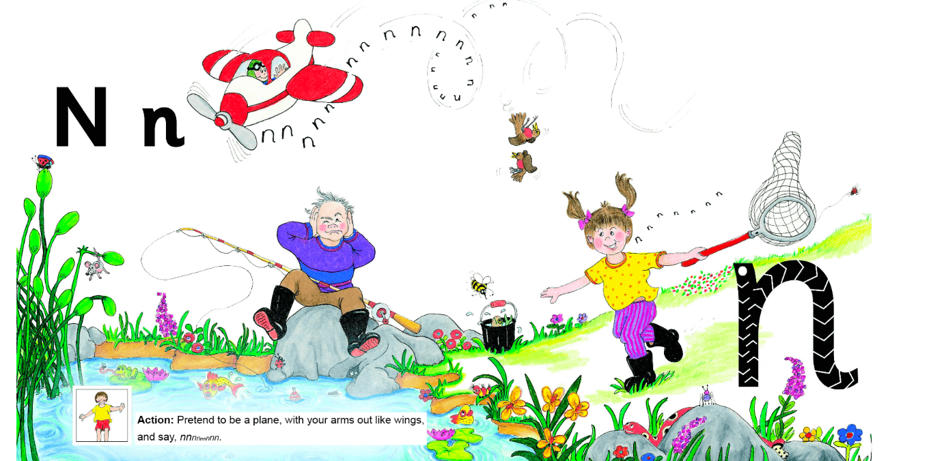
https://www.youtube.com/watch?v=oIKP8OQczoU

Slide 20


Slide 21
Make the action and the sound...
n
s
a
i
p
t

Slide 22
Cross the river if you have...
tin
pat
sat
pin

Slide 23






Make the initial sound:

